Slide 1
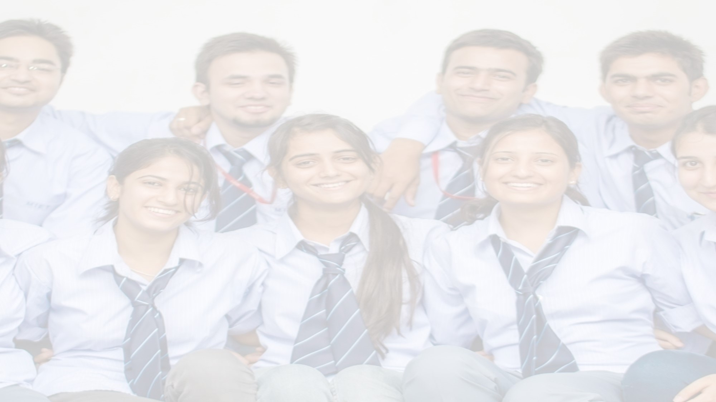


DEPARTMENT OF COMPUTER SCIENCE AND ENGINEERING
Major Project (COM-811) Presentation
B.Tech CSE 8th | Batch 2021-2025
PROJECT TITLE: AgeWell– A Smart Portal for Senior Citizen Support
Team Members:
1. Anjana Sharma(2021a1r011)
2. Khushi (2021a1r039)
3. Rakshit Gupta (2021a1r050)
\
Model Institute of Engineering & Technology (Autonomous)
Notes:
Presentation slide for courses, classes, lectures et al.

Slide 2
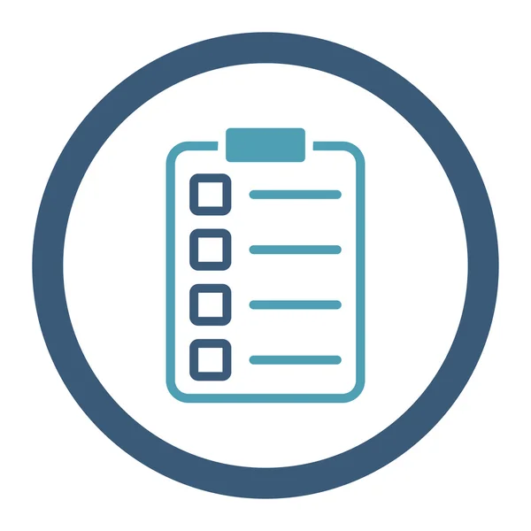
Table of Content
Introduction & Problem Statement
Project Objectives
Proposed Solution & Innovation
Methodology (Technology Stack)
System Architecture / Workflow
Implementation
Conclusion
Results / Outcomes
References

Slide 3
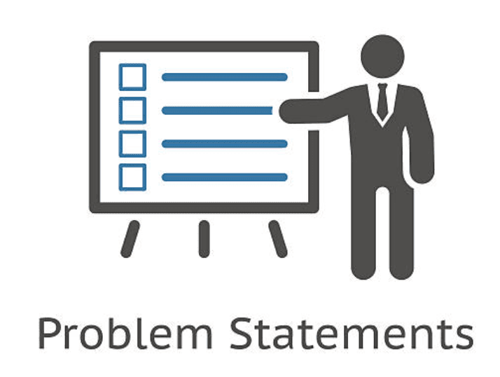
Introduction & Problem Statement
Introduction
Rapid digitalization has transformed daily life.
Elderly citizens often struggle with:
Complex app interfaces
Poor accessibility features
Limited digital literacy
This leads to:
Dependence on others
Missed medications or bills
Social isolation
Problem Statement
Existing platforms are not designed for senior users.
Seniors lack tools to manage:
Health schedules
Financial tracking
Tech learning
Reminders and emergencies
No unified solution for both independence and family monitoring.

Slide 4

Project Objectives
Core Functional Objectives
Design an easy-to-use digital portal tailored for senior citizens.
Create a platform for organizing and joining social events.
Enable expense tracking and bill reminders through a finance module.
Integrate a medicine reminder system with caregiver monitoring.
Offer a simple tool to set and manage daily task reminders.
Supportive Features
Provide a Learning Corner with digital guides and tutorial requests.
Introduce daily health and technology tips for ongoing awareness.
Ensure family involvement through a dedicated child user panel.
Include an admin dashboard for content control and feedback management.
Provide profile management with emergency contact options.

Slide 5
Proposed Solution & Innovation
Web-based portal: AgeWell
Senior-friendly interface (large fonts, simple navigation).
Modular design: Health, finance, learning, reminders.
Tips Module for daily wellness and tech guidance.
Child account linkage for family monitoring.
Admin Panel for content management and support.
Built-in notification system for platform alerts.

Slide 6



Methodology (Technology Stack)
Frontend:
HTML5, CSS3, Bootstrap 5
JavaScript, Jinja2 templates
Backend:
Flask (Python)
Database:
MongoDB (NoSQL)
Libraries/Tools:
FullCalendar.js (calendar views)
Chart.js (finance visualization)
Flask-Login & bcrypt (security)

Slide 7
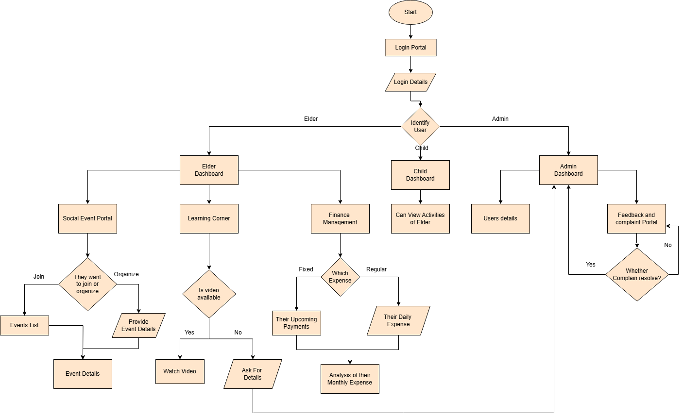
Detailed Flowchart

Slide 8
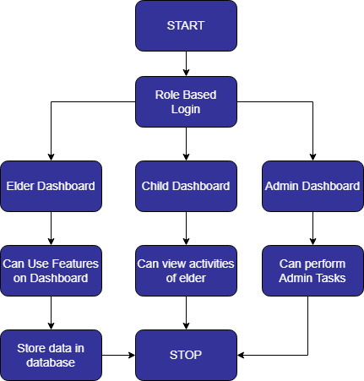
Workflow

Slide 9
Implementation
1. Dashboard Development
Created role-based dashboards:
Elderly Panel: Displays medicines, reminders, events, and tips.
Child Panel: Shows linked elder’s activity, medicine intake, and reminders.
Admin Panel: Manages tutorials, feedback, and user monitoring.
2. Module-wise Implementation
Medicine Management:
Add/edit/delete medicine entries.
Daily reminders with completion checkboxes.
Reminders Module:
Schedule personal reminders with date, time, and category.
Mark reminders as completed.
Finance Module:
Track regular and fixed expenses.
Visual summaries using Chart.js.
Social Events:
View, join, and create community events.
Calendar view using FullCalendar.js.
Learning Corner & Tips:
Static guides for WhatsApp, YouTube, UPI, etc.
Display daily health and tech tips dynamically.
3. Additional Functionalities
Child-Elder Account Linking: Enables child user to track their elder’s activity securely.
Notification System: In-platform alerts for medicines, reminders, bills, and tutorials.
Profile Section: Manage personal info, emergency contacts, and settings.
Admin Controls: Handle user feedback, tutorial requests, and user overview.

Slide 10
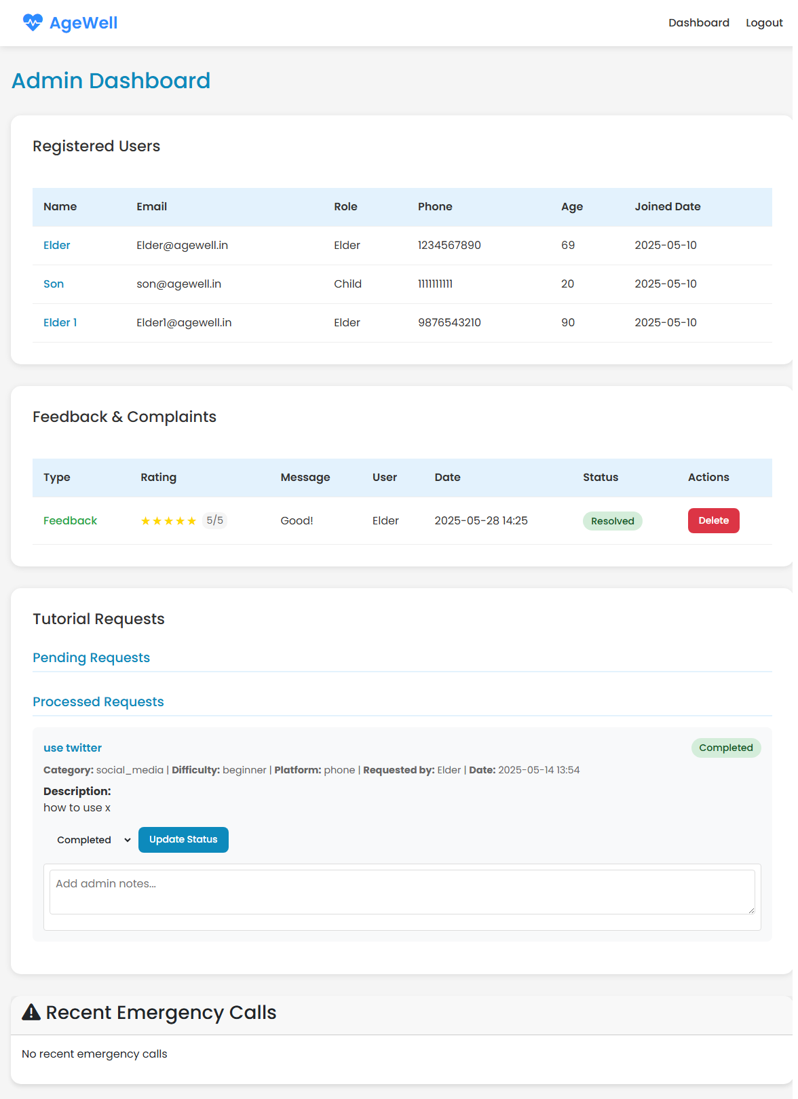
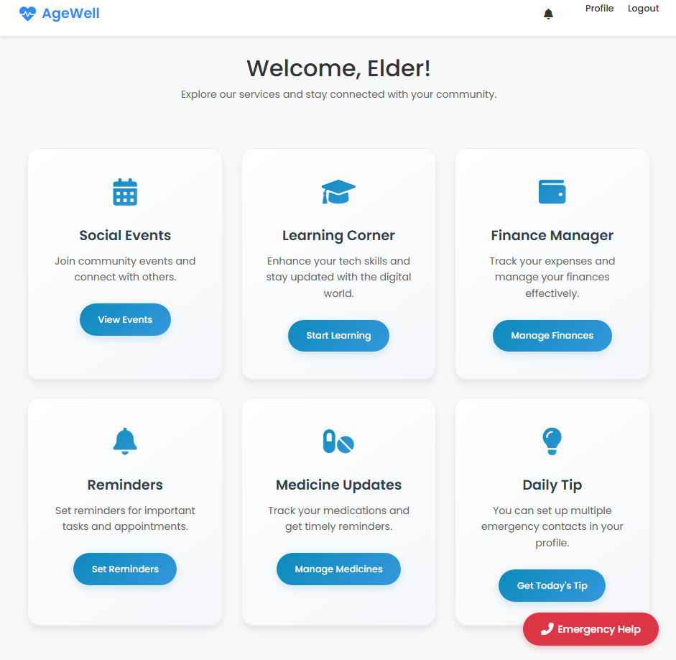
Results / Outcomes
10

Slide 11
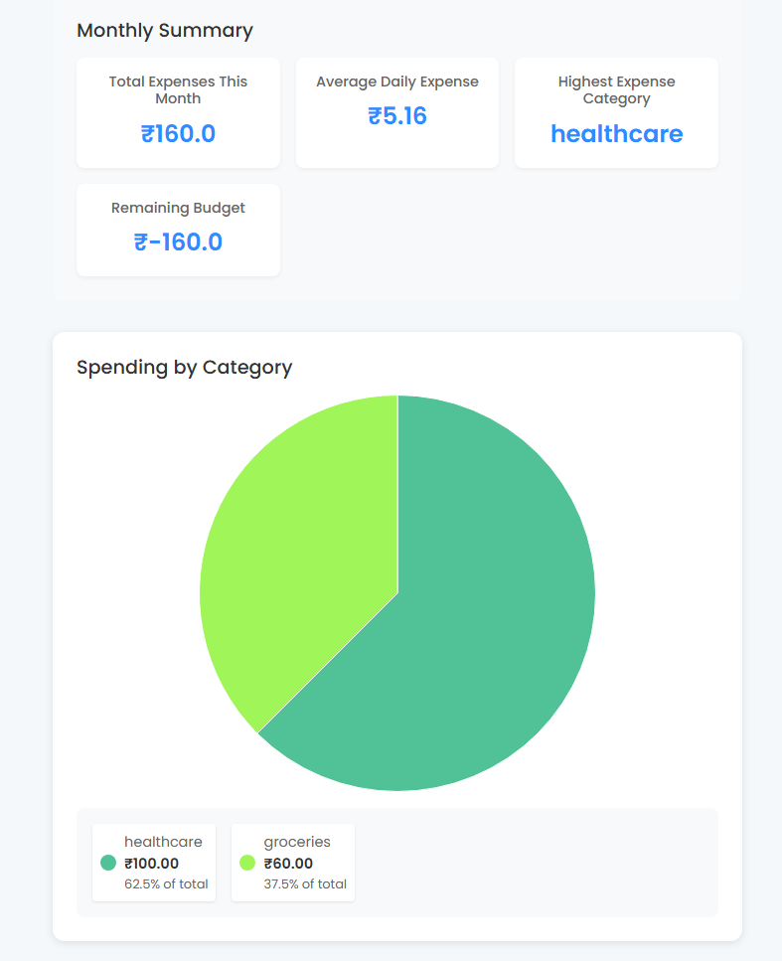
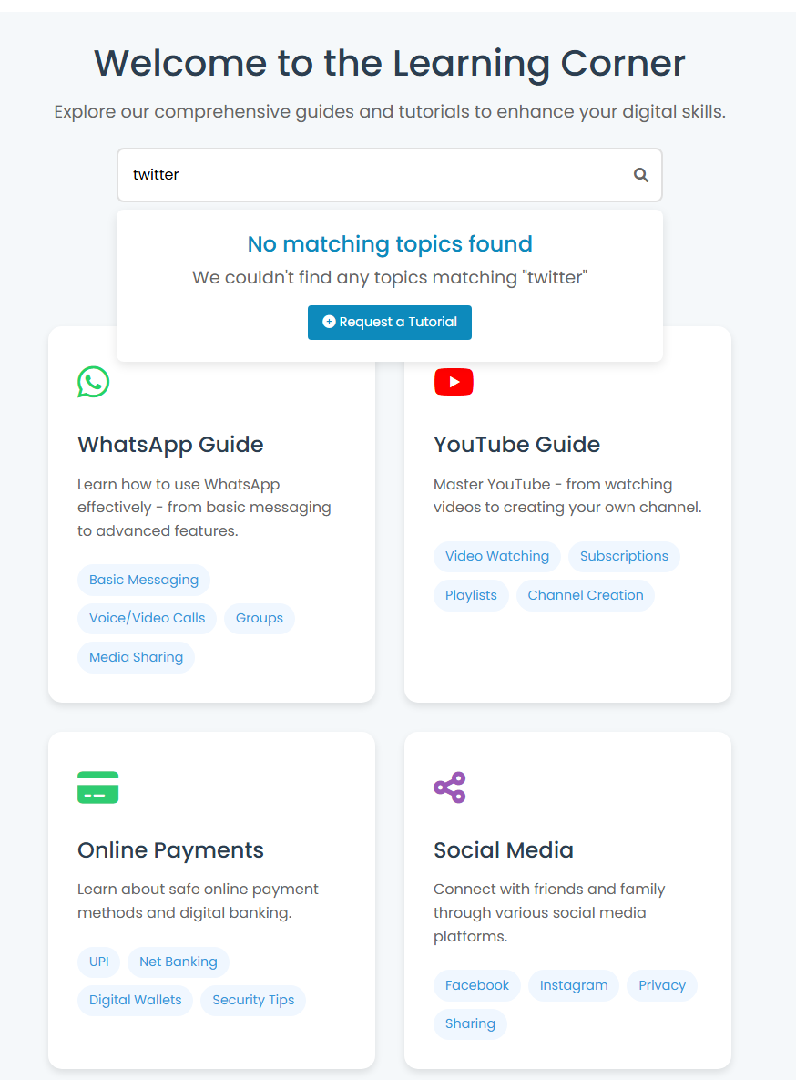
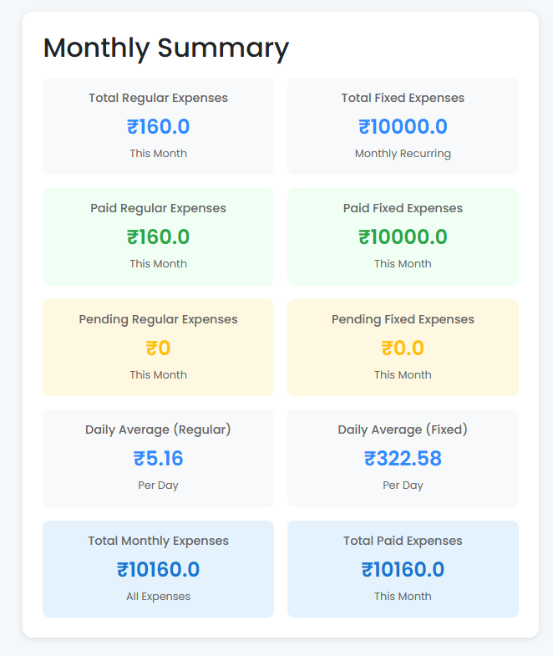
Results / Outcomes
11

Slide 12
Conclusion
12
Conclusion
AgeWell bridges the digital gap for elderly users.
Combines health, finance, learning, and family support.
Promotes autonomy and emotional well-being.
Future scope:
Voice integration
Multilingual support
Mobile app version
Visit The site: AgeWell

Slide 13
References
[1] A. Smith, “Digital Challenges for Aging Populations”, Proc. Int. Conf. Gerontology, 2020.
[2] B. Jones, “Empowering Seniors with Technology”, Symp. on Technology and Society, 2021.
[3] E. Lee, “Innovative Tech for Seniors”, J. Accessible Technol., vol. 9, no. 1, 2023.
[4] WHO, “Decade of Healthy Ageing 2021–2030”, 2021.
[5] Ministry of Digital Affairs, “Policy for Inclusive Digital Access”, 2024.

Slide 14
Thank You

